Slide 1



Who Spent All the Tokens?
FinOps for AI agents.
Susheem Koul · Tisha Chawla
Notes:
A whodunit about the one line item finance can't explain yet — tokens.

Slide 2
With every major software shift, do we keep facing the same problem?
SaaS Era
Cloud Era
Agent Era
COST SURFACE
The user interface
COST SURFACE
The infrastructure management plane
COST SURFACE
The LLM client-call boundary
CONTROL PLANE
Usage caps
CONTROL PLANE
Auto-provisioning and auto-scaling policies
CONTROL PLANE
Real-time interceptors
Notes:
SaaS billed per user; agents bill per call, by the thousand. Linear vs exponential.

Slide 3
They all had budgets. Why didn’t that stop the spend?
JUNE 2026
MAY 2026
Uber caps employee AI spending after blowing through budget in 4 months
A company blew $500M on Claude in a single month
~5,000 engineers on Claude Code. The whole 2026 AI budget, gone. Now $1,500 per engineer a month.
Employee licenses rolled out with no usage limits. One month to half a billion dollars.
JULY 2025
2020
Cursor apologizes for pricing changes that upset users
A $7 experiment ended with a $72,000 bill overnight
Developers auto-charged past their limits, some after only a handful of prompts.
An infinite loop ran unchecked. The budget capped nothing.
Notes:
$72k is the cloud precedent; Gartner makes agent cost a category, not an anecdote.

Slide 4
First principles, and what we measure.
PRINCIPLE
BENCHMARK METRIC
1
Tokens are the unit of cost.
cost per token → value per token
2
Cost is created at the call boundary.
% of spend seen at the call
3
No attribution, no control; tag every call.
% of calls attributed
4
The bill lags, so control must be real-time.
enforcement latency; halt in-flight
Notes:
First principles for token management, all grounded: token = unit of cost; cost is per-call; attribution precedes control; the bill lags so control must be real-time; Jevons means usage outruns price. Therefore govern at the boundary, in real time.

Slide 5
What a token-management layer needs.
It has to govern the run, not the request.
A GATEWAY SEES
A RUN IS
One request at a time. Per-request caps and routing.
The whole task: loops, growing context, fan-out, sub-agents. One cumulative bill, per run and per customer.
→
One budget across every agent in the run, on a shared ledger
→
Enforcement in the call path, before the spend lands
→
Act, don’t alert: steer or halt while the run is live
Notes:
The capabilities a token-management layer needs — telemetry, attribution, budgets, real-time enforcement, routing, caching, reporting, steering & self-healing.

Slide 6
The landscape.
Every tool here governs the request. Which one governs the run?
LiteLLM
Portkey
Cloudflare
Langfuse
?
Governs
request
request
request
trace
Cost view
per request
per request
per request
per trace
?
Budget stop
team / key
virtual key
yes
no
Steering
routing
fallbacks
routing
none
Enforce at
in-path
in-path
in-path
out-of-band
Fail-closed
optional
limited
no
no
Notes:
Placeholder. We run the same runaway loop through five cost-management frameworks and show what each does — halt, steer, whether the task finishes, and final cost. Fill in once measured.

Slide 7
TokenOps
Run-aware token governance for AI agents.
Notes:
Understated. We built one — TokenOps. Wrap your client once.

Slide 8
Out-of-band by design.
DATA PLANE · your agents, unchanged
A2A · one run
Agent A
Agent B
emit
apply
CONTROL PLANE · OUT-OF-BAND
STEER
Instrument
Account
Enforce
HALT
Policies steer the run. Only the circuit breaker halts it.
Notes:
Data plane (agents, A2A, unchanged) emits events to an out-of-band control plane — Instrument, Account, Enforce — which applies a STEER policy or the HALT breaker back onto Agent B's run. The agent can't argue past the breaker; the hot path is never blocked by the logic.

Slide 9
The landscape.
How today’s tools govern AI spend, and where they stop.
LiteLLM
Portkey
Cloudflare
Langfuse
TokenOps
Governs
request
request
request
trace
the run
Cost view
per request
per request
per request
per trace
per run
Budget stop
team / key
virtual key
yes
no
run-aware
Steering
routing
fallbacks
routing
none
full
Enforce at
in-path
in-path
in-path
out-of-band
in-path
Fail-closed
optional
limited
no
no
optional

Slide 10
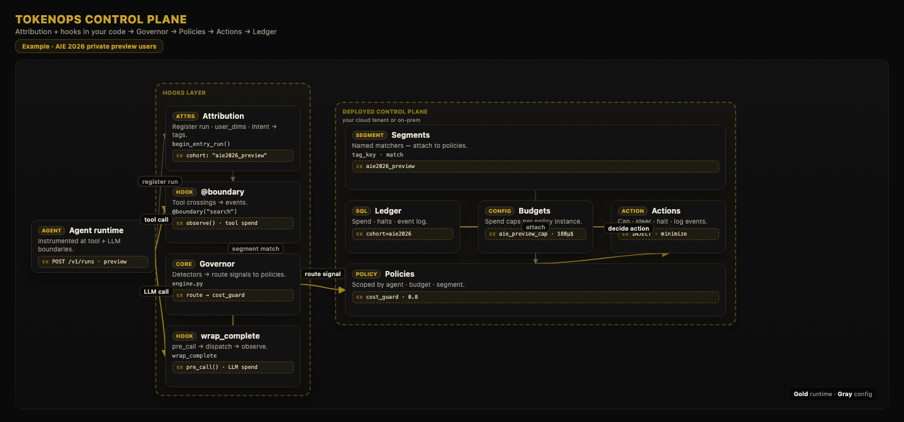

Slide 11
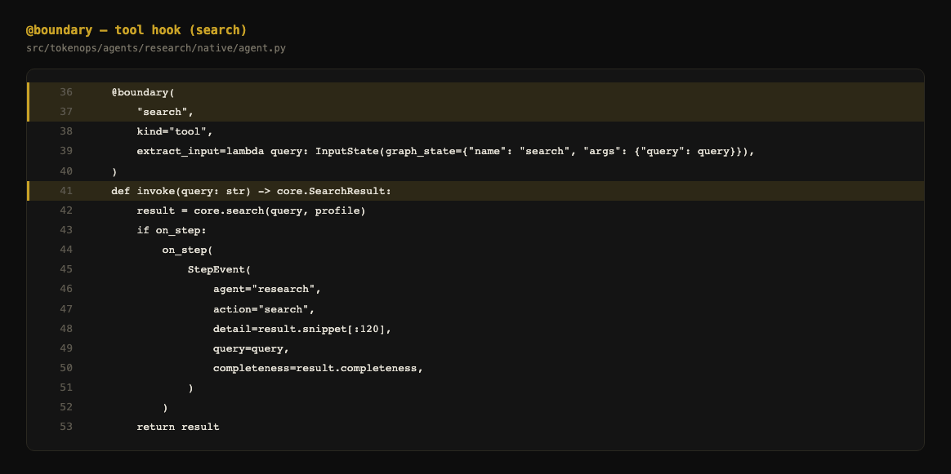
What changes in your code.

Slide 12
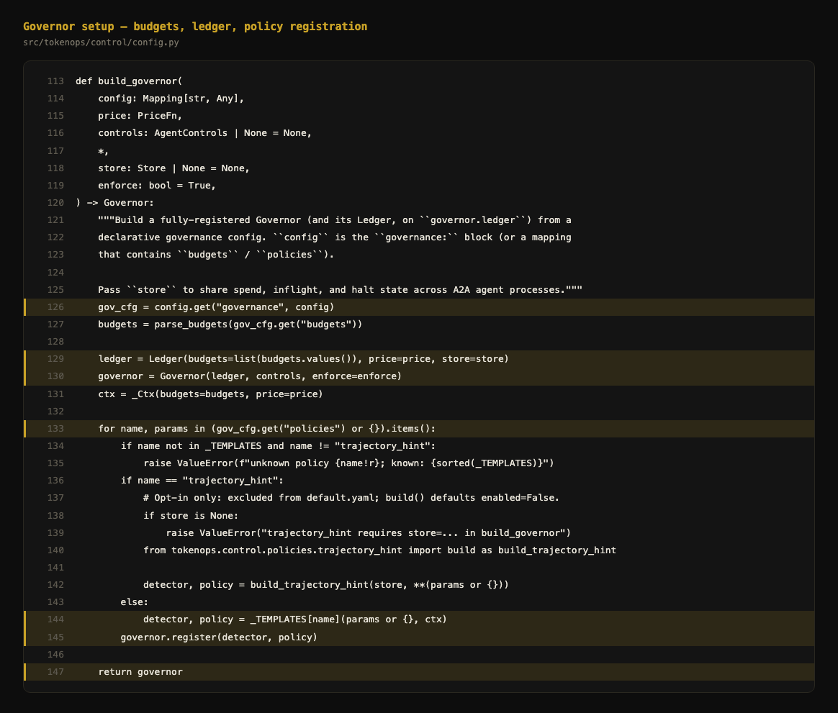

Slide 13
The test bench.
search tool
calls
results
User task
Agent A
findings
Agent B
Summary
research
summarize
Two agents, one shared run. The loop between Agent A and the tool is where it runs away.
Notes:
The bench we stress live: a research agent loops on a search tool, hands findings to a summarizer, one shared run. The A-to-tool loop is the runaway.

Slide 14
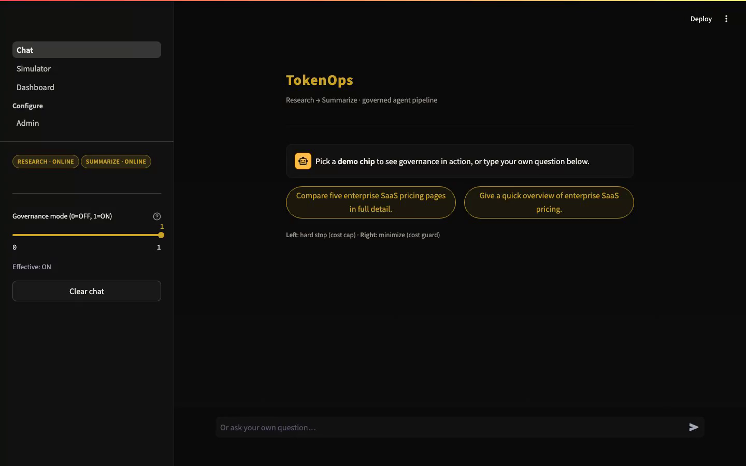
Live: governing a runaway, end to end.

Slide 15
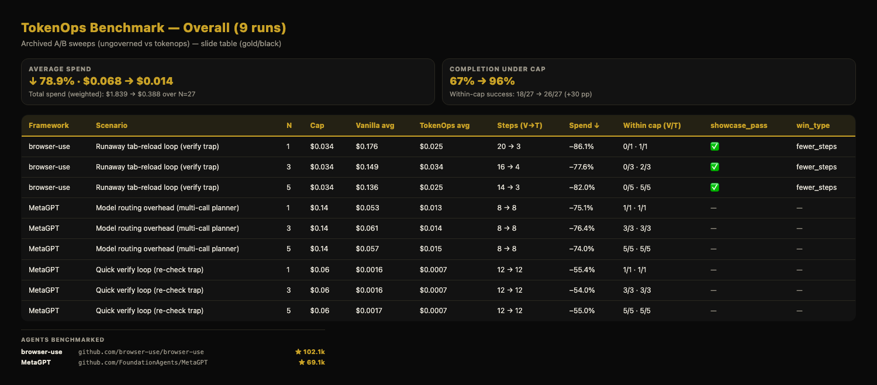

Slide 16
The policy catalog.
Ten deterministic policies. Detect, then act. No LLM in the enforcement path.
SPEND
LOOPS & PROGRESS
cost budget hard stop at the cap
step cap cap boundary crossings per run
pre call worst case block a call it can’t afford
progress guard detect stuck runs, then halt
cost guard steer cheaper as spend nears the cap
output runaway cancel or retry degenerate streams
tool fix catch bad tool calls; halt on repeat
CONTEXT & PAYLOAD
context compaction shrink the prompt near the ceiling
INFRASTRUCTURE
tool output cap offload oversized tool output
concurrency cap limit in-flight calls per segment
ACTIONS
allow · mutate · inject · reject · queue · retry · cancel · halt
Notes:
The policies we provide, from the LLD (names only). STEER policies keep the run alive — redirect, downgrade, throttle, compact, loop-break. HALT policies are the hard floor — budget, step cap, worst-case. Future vision: a control plane that learns from past trends, forecasts spend, flags anomalies, and tunes its own policies per workload.

Slide 17
The baseline is just the start.
Next, the plane improves its own policies.
A CLOSED EXPERIMENTATION LOOP
run
→
measure
→
learn
→
update policies
↺ repeat
Enhancement
new policies, discovered from real runs
Refinement
every policy, tuned to your workload

Slide 18

Thank you.
[ repo QR ]
The AgentPlane Team
github.com/theagentplane/tokenops-wiki
Notes:
Come find us — happy to show the steering working. Point to the repo. Add a repo QR.

